Slide 1
Vermont Participation in the Transportation and Climate Initiative
Initial Vermont Stakeholder Meeting ​
May 14, 2019​
2 – 4 PM​
National Life Campus, Dewey Building

Slide 2
Vermont TCI Team - Leadership
Peter Walke – Deputy Secretary, Agency of Natural Resources
Michele Boomhower - Director of Policy, Planning and Intermodal Development, VTrans
Dan Dutcher – Environmental Policy Manager, VTrans
Riley Allen – Deputy Commissioner, Department of Public Service

Slide 3
Vermont TCI Team - Staff
Agency of Natural Resources
Heidi Hales – Director, Air Quality and Climate Division
Elle O'Casey - Communications Director
Megan O’Toole – Attorney, Air Quality and Climate Division
Collin Smythe, Brian Woods – Environmental Analysts
VTrans
Dan Dutcher – Environmental Policy Manager
Department of Public Service
Dan Potter – Energy Policy and Program Analyst
Agency of Commerce and Community Development
Ken Jones – Economic Research Analyst

Slide 4
Why Focus on Transportation Emissions?

Slide 5
Scale of Change Needed

Slide 6
The Path Forward

Slide 7
Snapshot: What are we working on already?​
VW Settlement Fund Investments
Electric Vehicle Supply Equipment (EVSE) grant program
Electric school and transit bus pilot program
EV Incentive in Legislation
Tier III
PUC EV Proceeding / DPS Rate Design
Complete Streets
ZEV Action Plan
ZEV Mandate
T-Bill Study of Feebate

Slide 8
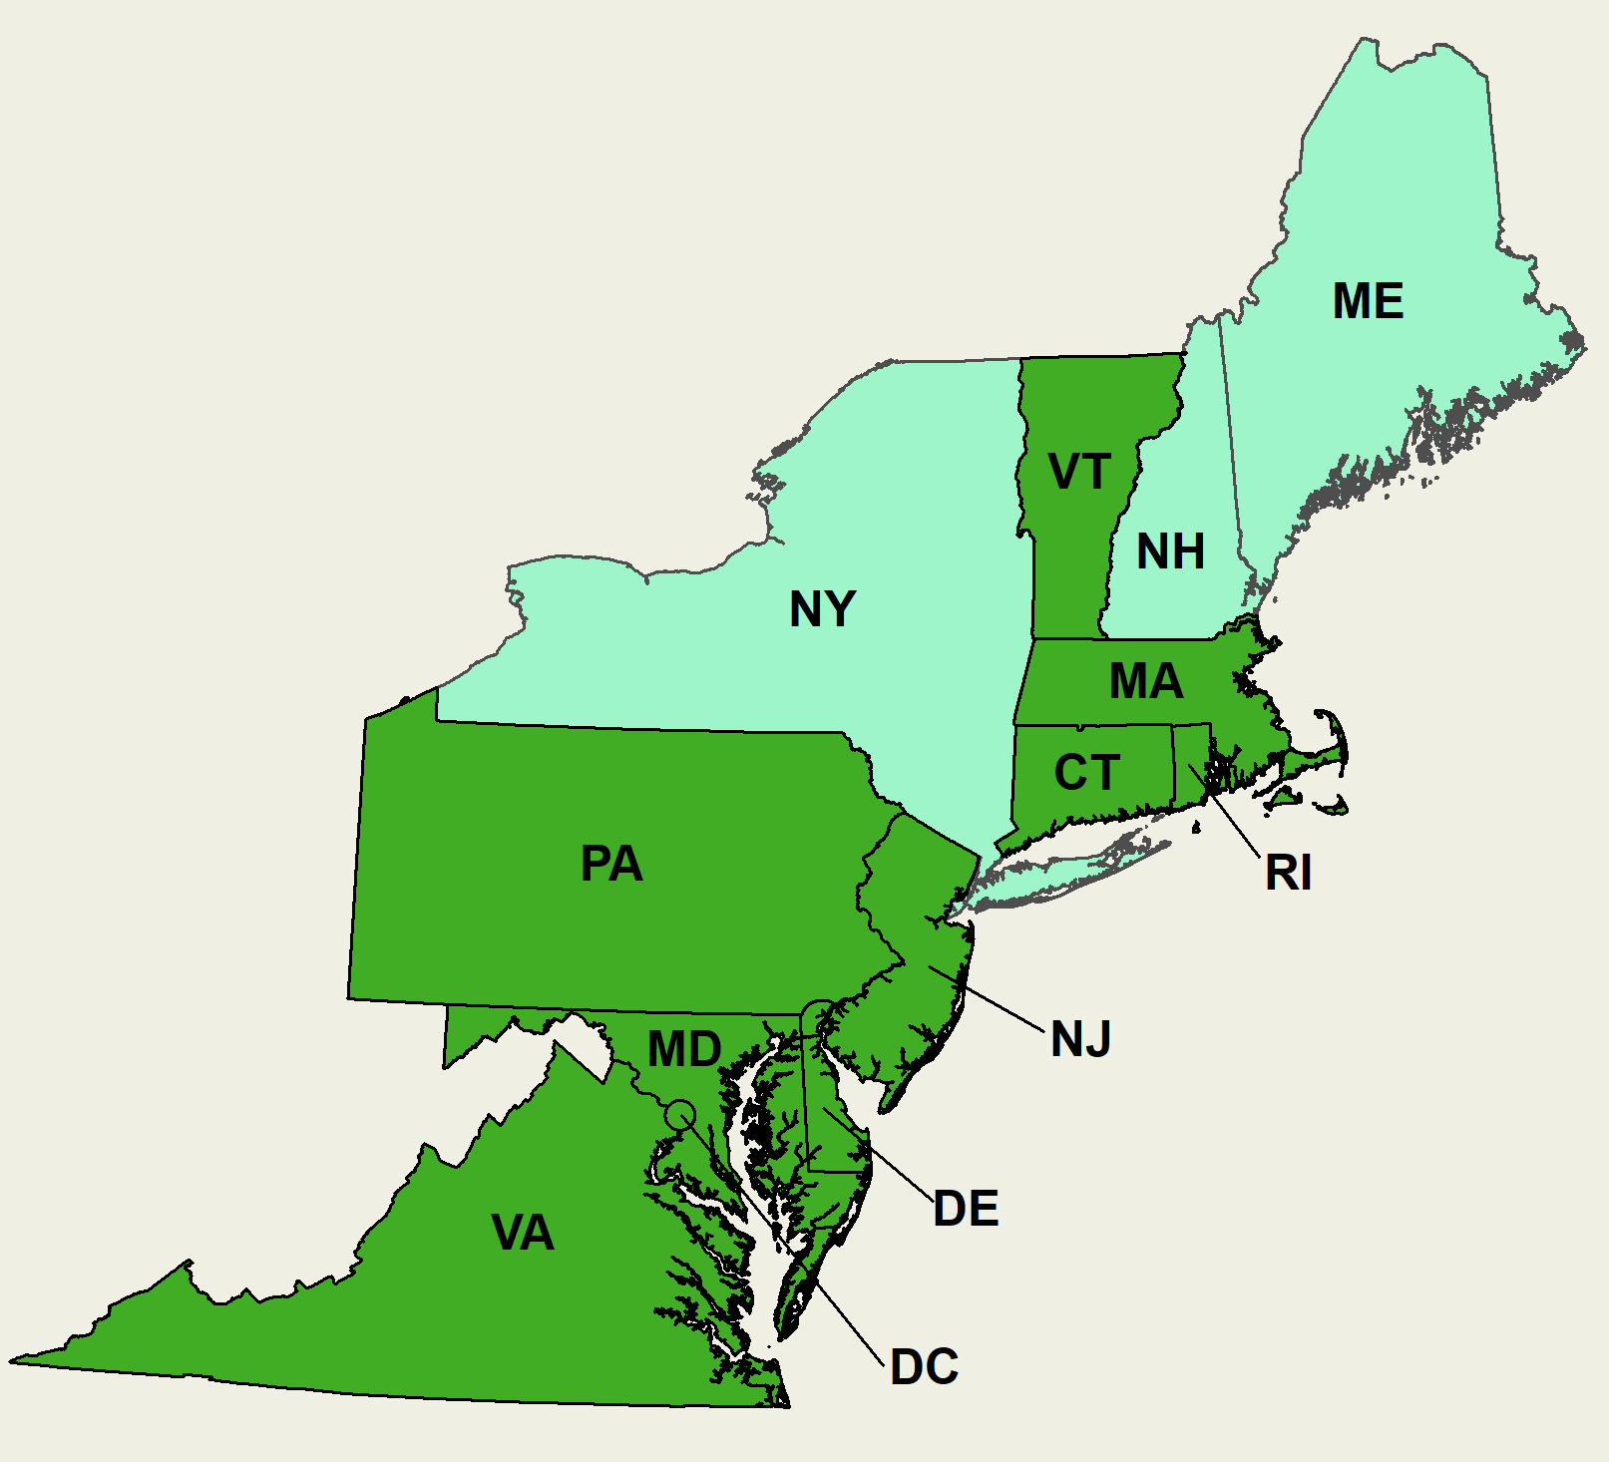
TCI Overview
Working since 2010 to address transportation emissions​
December 2018 Statement: ​
“Informed by input from hundreds of stakeholders and expert analysis, the participating TCI jurisdictions will design a regional low-carbon transportation policy proposal that would cap and reduce carbon emissions from the combustion of transportation fuels through a cap-and-invest program or other pricing mechanism, and allow each TCI jurisdiction to invest proceeds from the program into low-carbon and more resilient transportation infrastructure. This proposed program, when combined with existing programs and complementary policies, will be designed to achieve substantial reductions in transportation sector emissions and provide net economic and social benefits for participating states.”​
Notes:
We are designing the best program possible - no ultimate decision
No decisions made
Why Cap and Invest – part of a suite

Slide 9
What is Cap-and-Invest?
Set an annual declining cap on emissions
Auction allowances equal to the cap
Invest proceeds in emissions-reductions actions to lower the cost of compliance

Slide 10
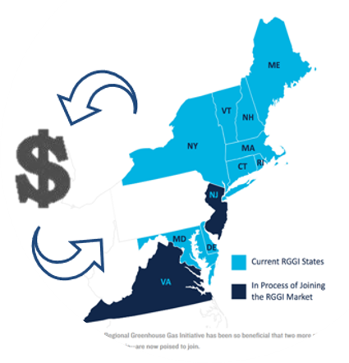
Regional Model for Success - RGGI
Nine Northeast and Mid-Atlantic states formed a market-based mechanism for reducing GHG emissions from the power sector​
Emissions’ generators purchase “allowances” at auctions and in a secondary market​
States determine investments into efficiency and affordability initiatives​
A declining cap on total regional CO2 emissions has resulted in more than 40% reduction in emissions

Slide 11
How Might a Cap-and-Invest Work for Transportation?
Cap sets the reduction requirements, auction proceeds invested in programs to help Vermonters reduce emissions and save money​
Investments enable all Vermonters to share in the benefits of cost-saving technology​
Potential investments (subject to Legislative appropriations):​
Public transit​
Active transportation​
EV incentives​/infrastructure
Renewable fuels

Slide 12
For Modeling Purposes: Fuels Covered and Compliance Entities
Fuels covered:​
Gasoline and on-road diesel ​
Point of regulation – “Prime Suppliers”​
Definition: A firm that produces, imports, or transports selected petroleum products across State boundaries and local marketing areas, sells the product to local distributors, local retailers, or end users (EIA definition).

Slide 13
High-Level Timeline for TCI Development
Actions to date:​
Research into transportation and fuels system conducted since 2010
Initial TCI regional listening sessions completed​
Joint statement released to participating states in December 2018​
Multi-jurisdictional governance structure established​
Initial fuel coverage and point of regulation agreement reached​
Modeling considerations in development​
By end of 2019: Complete and publicly release a policy proposal​
By end of 2020 (if VT concurs): Vermont General Assembly enacts enabling legislation and begins to explore potential investment scenarios​
2021/2022 (if VT concurs): program established, rev. allocated to states

Slide 14
2019 Timeline
April 30, 2019 – Public Technical Workshop, Boston, MA​
Today – Initial Vermont Stakeholder Meeting
May 15, 2019 – Public Equity and Investment Workshop, Newark, NJ
May 23, 2019 – Stakeholder Input on Modeling Assumptions, Webinar
July 30, 2019 – Stakeholder Workshop, Baltimore, MD
August/September 2019 – Stakeholder input on potential cap scenarios​
September/October 2019 – Sub-regional rural transportation discussion with northern New England states
December 2019 – States agree to final policy decision proposal and announce whether they will commit to participate

Slide 15
Break for Questions

Slide 16
Regional Modeling and Program Considerations
Fuels Covered (and not Covered)
Compliance Entities
Emission Cap
Allowances and Auction
Flexibility and Market Stability Measures
Monitoring, Verification, Reporting
Apportionment of Proceeds Amongst States (different potential formulas)
Investment Guidelines (if any)
Links to other programs
Notes:
Brian Woods
TCI Prime Suppliers
Regionally - about 100 entities
VT - 25 entities
Transportation Sector Emissions
Regional - 295M tons (units)
VT - ~1%

Slide 17
Vermont-specific Considerations
Who pays the costs? Who benefits? How do we answer these questions? ​
How do we address equity?​
How can rural and low-income Vermonters benefit from this program?​
How will Vermont stakeholders engage?​
What is the role of the legislature?​
Notes:
Ken Jones

Slide 18
Vermont Investment Options:
Potential programs in which to invest proceeds:
Transit expansion
EV subsidy
EV charging
Biofuels investments
Walk and bike infrastructure investments
Incentive for compact development to reduce VMT requirements
Targeted programs for low-income and rural households
Targeted programs for business competitiveness
Other

Slide 19
Vermont Investment Considerations
Cost effectiveness
Public dollars per ton of carbon reduced
Public plus private dollars per ton of carbon reduced
“Priming the pump” – incentives that help build a longer term market
Equity
Link the benefits to those that are paying the additional fuel costs
Protect lower income households where the additional fuel costs harm other purchase decisions
Other Vermont impacts
Economic/Workforce Drivers
Tourism Benefits/Impacts

Slide 20
Stakeholder Questions and Comments

Slide 21
Stakeholder Resources and Portals
TCI: https://www.transportationandclimate.org/main-menu/tcis-regional-policy-design-process-2019
Vermont: Under construction

Slide 22
Closing Remarks

Slide 23
TCI Model Flow Chart

