Slide 1
Vermont’s American Rescue Plan Act Program to Abate Combined Sewer Overflows
11/9/2021
Tom Brown, Padraic Monks, Lynnette Claudon – Water Infrastructure Division
Amy Polaczyk – Watershed Management Division

Slide 2
Introductions
Amy Polaczyk, Manager, Wastewater Program, WSMD
Padraic Monks, Manager, Water Infrastructure Finance Program, Water Investment Division (WID)
Tom Brown, CWSRF Project Developer, WID
Lynnette Claudon, Chief Pollution Control Design Engineer, WID

Slide 3
CSO background
Facility Name | Receiving Water | No. of Outfalls
Burlington Main | Lake Champlain | 3
Burlington East/River | Winooski River | 1
Burlington North | Winooski River | 1
Enosburg Falls | Missisquoi River | 1
Hartford / WRJ | Connecticut River | 5
Middlebury | Otter Creek | 4
Montpelier | Winooski River | 6
Newport City | Clyde River | 6
Northfield | Dog River | 1
Rutland | Otter Creek | 4
St. Johnsbury | Passumpsic River | 15
St. Albans | Lake Champlain via Stevens Brook | 1
Vergennes | Otter Creek | 1

Slide 4
CSO rule
The purpose of this Rule is to protect public health and the environment by ensuring that all remaining Combined Sewer Overflows (CSOs) in the State are brought into compliance with the requirements of state and federal law, including the Vermont Water Quality Standards (VWQS).
This Rule supersedes the state of Vermont’s “Combined Sewer Overflow Control Policy,” dated June 1990.
2-Phased approach:
Implement Nine Minimum Controls (NMCs) and devise LTCP
Continue NMC implementation, implement LTCP.

Slide 5
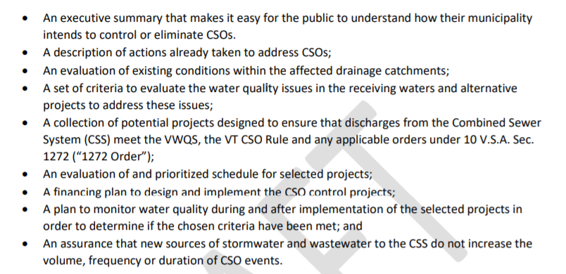
Long Term Control Plans
The goal of a CSO LTCP is to achieve compliance with water quality standards in the receiving waters.

Slide 6
ARPA Funding Available
FY22 - $10 Million, allocated based on Priority List
FY23 & FY24 – anticipate $10 Million/year
GOAL: Provide financial support for communities to implement projects in their LTCPs.

Slide 7
What can the funding be used for?
Projects that abate or treat CSO & SSO overflows
Separation, Storage, Slip Lining
Green & Gray Stormwater Infrastructure
Monitoring, Data, Analysis
Notes:
Lynnette

Slide 8
Cross-cutters
Apply if there is co-funding with CWSRF or DWSRF or other applicable federal source
NO Disadvantaged Business Enterprise
NO Davis Bacon, unless project is more than $10M.
NO American Iron and Steel
NO NEPA
Notes:
Lynnette

Slide 9
How to Apply
Complete a Priority List Application
If additional info is needed, we will reach out

Slide 10
When to Apply
State Fiscal Year | Priority List Application Deadline | Typical Intended Use Plan State Date | Typical Intended Use Plan End Date
SFY 22 | December 2021 | Current IUP (now) & Amended IUP (TBD) | June 30, 2022
SFY 23 | Late February 2022 | July 1, 2022 | June 30, 2023
SFY 24 | Late February 2023 | July 1, 2023 | June 30, 2024

Slide 11
Questions?
Amy.Polaczyk@vermont.gov

